Slide 1

Counter Cyberbullying
With #include<AWESOME.H>

Slide 2
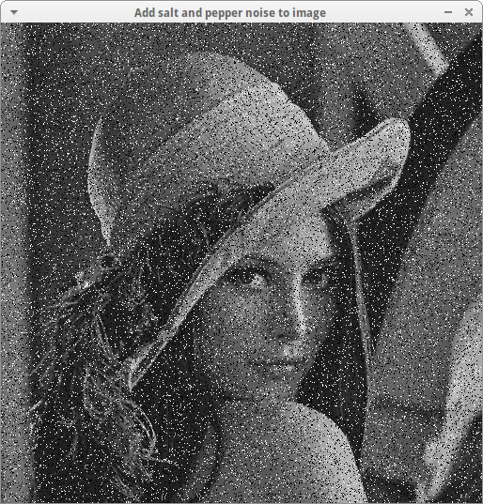
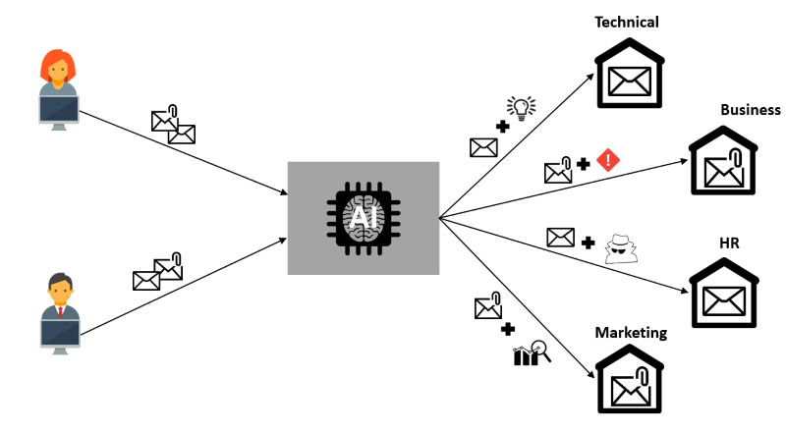
Underlying methodology
Input
(Noisy images)
Computer Vision
algorithms
Classification and Catalog
1

Slide 3
Image Preprocessing
Data Preparation
We used data given to us to get valuable insights and common miss errors, and worked on resolving them for better understanding.
Data Transformation
Deskewing and augmentation to get more sample features from the text was performed via rule based approaches, with dynamic threshold settings.
1

Slide 4


Why the current stack?
OpenCV
Tesseract
1

Slide 5

Approach
Recurring noise is identified and masked using a 3 filter metric.
Vision api call is layered on top of the preprocessing.
Catalog construction is done via matrix matches – using vision co-ordinates
Post pruning on flexible db structures for categorization
1

Slide 6
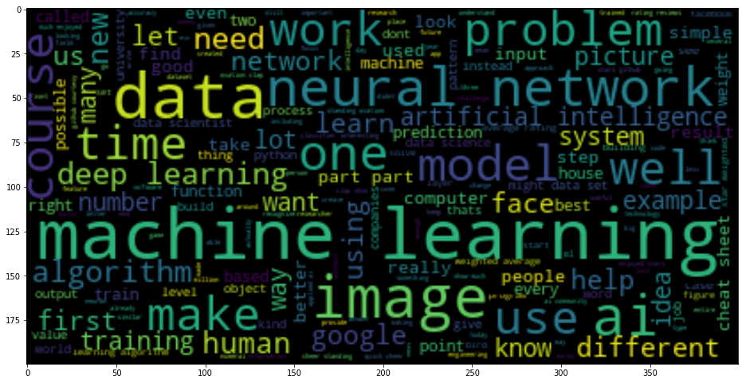
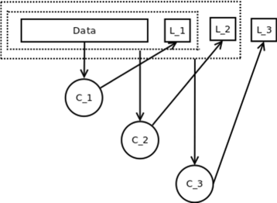
Idea drive for the near future
1
Unstructured metadata ( formatted for machine comprehension )
Structured, deterministic modeling for digitization and categorization
As the system acquires / learns more data, the scalability of spaCy extends flexibility and ease of management, making our project industry ready and deployable.
1

Slide 7

Simple > Powerful...or is it?
With our model, you can leverage both – simplicity in visualization, and powerful backend with spaCy and Keras.

